Slide 1

Getting to know your NTFS INDX Records
Willi Ballenthin (@williballenthin)

Slide 2
Scenario

Slide 3
Scenario Context
A three letter government agency contacts your company. They've seen a few hundred megabytes of sensitive data leave your network, bound for a foreign country. Don't ask how they know, but you might want to check HOST-A.

Slide 4
Attacker's Perspective
- Connect to a persistent backdoor on HOST-B.
- Move laterally to HOST-A.
- Execute cd C:\WINDOWS\Temp.
- Execute
rar.exe a 1.rar "X:\Private Parts".
- Run a utility to HTTP POST 1.rar back home.
- Execute del 1.rar.
- Exit.

Slide 5
Defender's Perspective
HOST-B is compromised, you've found malware.
Is HOST-A compromised? Consider,
there is no persistent malware, and
there are no suspicious archives on disk, and
there might be residual artifacts, such as
prefetch entries, etc.
Let's try the following...

Slide 6
Defender's Perspective, 2
You might try the following:
- Look at active and deleted file listings.
- Review event logs.
- Scan prefetch entries.
- Parse shellbags.
- Run keyword searches for "Rar!".
- Dissect memory images.
- Perform a MFT search for ".rar".
- What else?

Slide 7
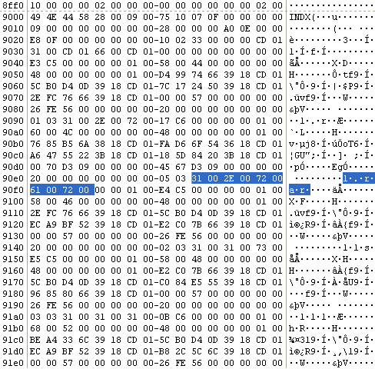
MFT search results
What is this thing?
I see a filename,
a file size,
MACB times.

Slide 8
MFT search results, 2
Hint.

Slide 9
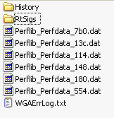
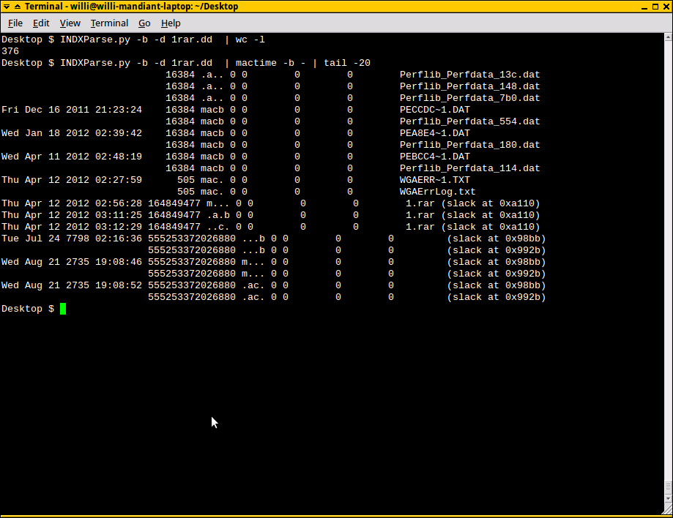
INDX records == artifact goldmine
parsing INDX records, +367 artifacts.

Slide 10
Cool.

Slide 11
My job, in three questions
Consider a network, what systems are
compromised?
Given a system, is it compromised? To what extent?
If a system is compromised, how does it help
me find other systems that are compromised?

Slide 12
My job, in three questions
Consider a network, what systems are
compromised?
Given a system, is it compromised? To what extent?
If a system is compromised, how does it help
me find other systems that are compromised?
goto 1

Slide 13
INDX records to the rescue
INDX records help me identify malware or data
exfiltration long after the files have been deleted
from disk.
- Filenames and filesizes go immediately into IOCs.
- Timestamps get inserted into a global timeline that
identifies periods of malicious activity.

Slide 14
Review:
NTFS file system forensics

Slide 15
NTFS Layout, 1x detail (volume level)
VBR
MFT
File Contents
MFT Record
Cluster offset
Cluster offset
NTFS organizes file content and
directory structures on
volumes.
Metadata is stored as records in
the MFT.
Each file or directory has an MFT
record.
File content is spread throughout
the volume.

Slide 16
NTFS Layout, 10x detail (MFT record level)
Record Header
Attributes
Slack
The MFT is made up of a list of
MFT records.
MFT records are 1024 bytes long.
Large attributes are non-resident.
Example attributes:
- Filename Information
- Standard Information
- $DATA (files)
- $I30 (directories)

Slide 17
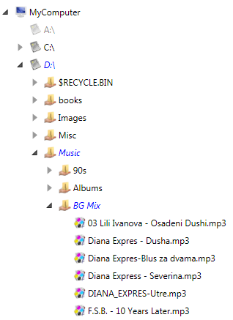
NTFS Layout, 7x detail (logical view)
MFT record parent
references can be
used to reconstruct the
directory hierarchy.
Every MFT record has a
link to its parent record.

Slide 18
NTFS Layout, 7x detail (logical view)
MFT records for
directories also have
indices for each of the
files it contains.
These are organized in
the "$I30" attributes, or
"INDX records".
Dirs
Files

Slide 19
NTFS Layout, 100x detail (INDX record level)
Record Headers
Slack space
Record Entries
INDX attributes are allocated in
multiples of 4,096 bytes.
INDX entries follow a header in
generally alphabetical order.
An entry tracks a file in a directory,
and contains $FN information, including:
- filename
- filesize
- filename MACB timestamps
- other NTFS metadata

Slide 20
NTFS Review, tl;dr
Many forensic tools look for the structure associated
with a file when recovering deleted artifacts.
These tools often ignore tiny records stored in the
structures associated with directories.
By looking for INDX records in slack spaces, tools
may recover significant deleted artifacts.

Slide 21
Try it at home!

Slide 22
EnCase (well, EnScripts)
EnCase does not parse INDX records natively.
EnScripts may be used to parse the structures:
- "Examples/Index buffer reader".
- 42 LLC provides the INDX Extractor Enpack
https://42llc.net/?p=336.

Slide 23
FTK
When viewing a directory, FTK will display
non-resident NTFS INDX attributes as an
"$I30" file.
You can export this file and parse it with a tool such
as "INDXParse.py".

Slide 24
The Sleuthkit
First, use istat to identify the IDs of the NTFS INDX
attributes of an inode (*-144-* and *-160-*):
istat -f ntfs ntfs.dd 49
.... Attributes: Type: $STANDARD_INFORMATION (16-0) Name: Resident size: 72
... Type: $I30 (144-6) Name: $I30 Resident size: 26
Type: $I30 (160-7) Name: $I30 Non-Resident size: 4096

Slide 25
The Sleuthkit, 2
Then, use icat to extract the content of INDX
attributes:
icat -f ntfs ntfs.dd 49-144-6 >
INDX_ROOT.bin
icat -f ntfs ntfs.dd 49-160-7 >
INDX_ALLOCATION.bin
Finally, parse the output with a tool such as
"INDXParse.py".

Slide 26
INDXParse.py
INDXParse.py is a Python script I wrote to extract
meaningful information from INDX records.
INDX records in, CSV (-c) or Bodyfile (-b) out.
The tool identifies and parses slack entries (-d).
www.williballenthin.com/forensics/indx/index.html

Slide 27
Questions?

